Slide 1

Library Management System

Slide 2
.
About me
👨‍🎓 Education
Degree: BTech-CSE
University: Nadimipalli Satyanarayana Raju Institute of Technology
Year of Graduation: 2024
🎯 Why I Want to Learn Data Analysis
To gain the insights from data and support data-driven decision making
To develop strong analytical skills and problem-solving abilities.
To learn how to use tools like Excel, SQL, and Python for real-world analysis.
🌐 Profiles
LinkedIn: https://www.linkedin.com/in/pilla-pravallika-
GitHub: https://github.com/Pravallika1902

Slide 3
Agenda
Objective of the Project
ER Diagram and schema explanation
Key analysis questions
SQL query results with screenshots or summaries
Final business insights and recommendations
Conclusion
Q&A
My Experience/Challenges working on this SQL – Data Analysis Project.

Slide 4
Objective of the Project
The objective of the Library Management System project is to design and implement a relational database that efficiently manages the operations of a library. This includes storing and retrieving information about books, authors, publishers, borrowers, library branches, book loans, and inventory. The system aims to support day-to-day library activities such as book lending, tracking due dates, managing multiple branches, and analyzing library performance through data-driven insights.

Slide 5
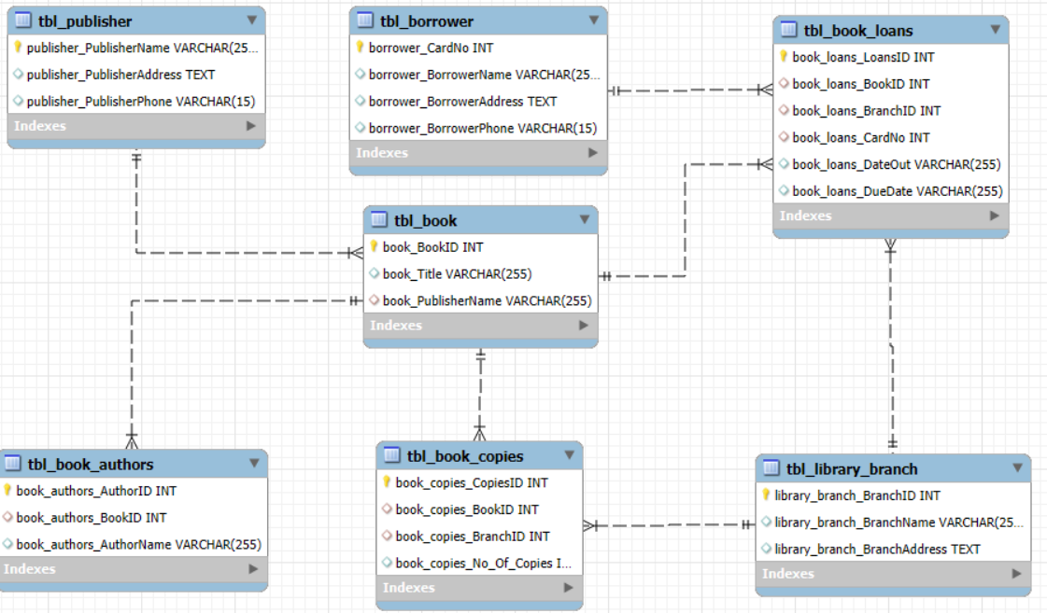
ER Diagram

Slide 6
Database Schema Explanation
The database consists of the following interconnected tables:
Table Name | Purpose
tbl_publisher | Stores details of book publishers including name, address, and phone.
tbl_book | Stores book information such as title and publisher.
tbl_book_authors | Maintains the list of authors and the books they’ve written.
tbl_library_branch | Stores data of all library branches including name and address.
tbl_book_copies | Tracks how many copies of each book exist in each branch.
tbl_borrower | Holds information about library users including name, address, and phone.
tbl_book_loans | Records which borrower has borrowed which book, from which branch, and when.

Slide 7
Key Analysis Questions
How many copies of the book titled "The Lost Tribe" are owned by the library branch whose name is "Sharpstown"?
How many copies of the book titled "The Lost Tribe" are owned by each library branch?
Retrieve the names of all borrowers who do not have any books checked out.
For each book that is loaned out from the "Sharpstown" branch and whose Due Date is 2/3/18, retrieve the book title, the borrower's name, and the borrower's address.
For each library branch, retrieve the branch name and the total number of books loaned out from that branch.
Retrieve the names, addresses, and number of books checked out for all borrowers who have more than five books checked out.
For each book authored by "Stephen King", retrieve the title and the number of copies owned by the library branch whose name is "Central".

Slide 8
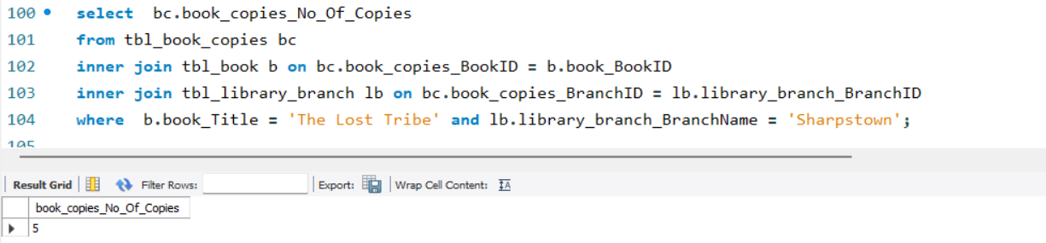
1.How many copies of the book titled "The Lost Tribe" are owned by the library branch whose name is "Sharpstown"?

Slide 9
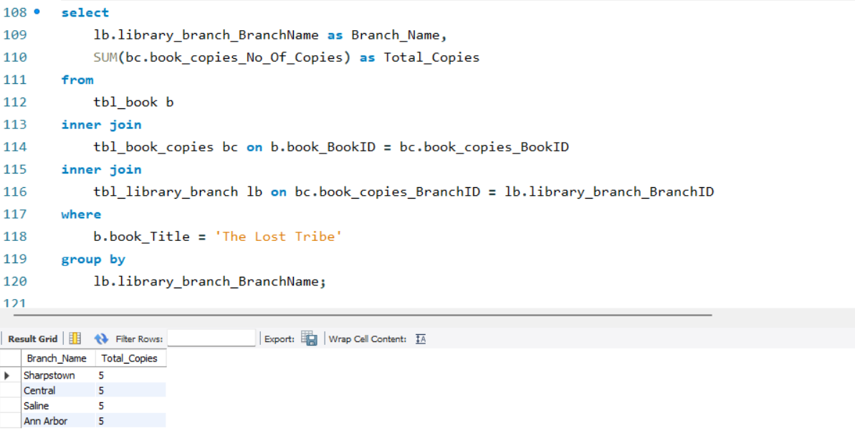
2.How many copies of the book titled "The Lost Tribe" are owned by each library branch?

Slide 10
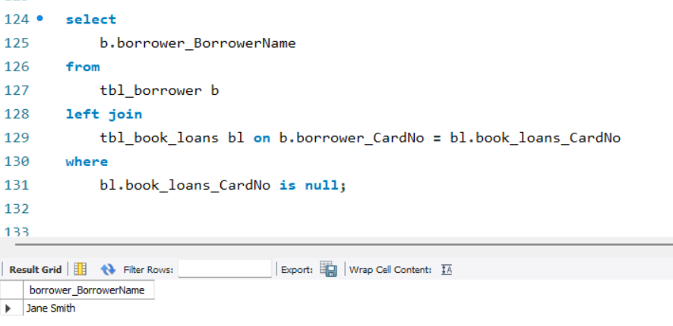
3.Retrieve the names of all borrowers who do not have any books checked out.

Slide 11
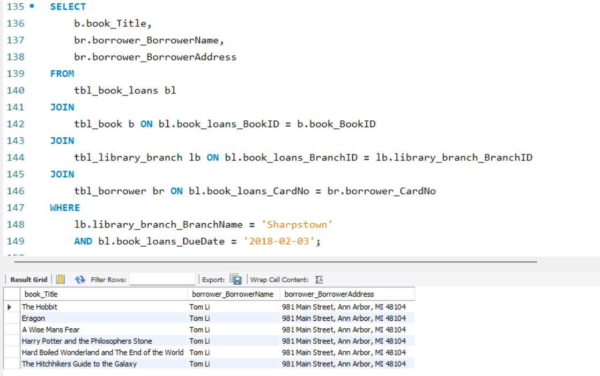
4.For each book that is loaned out from the "Sharpstown" branch and whose Due Date is 2/3/18, retrieve the book title, the borrower's name, and the borrower's address.

Slide 12
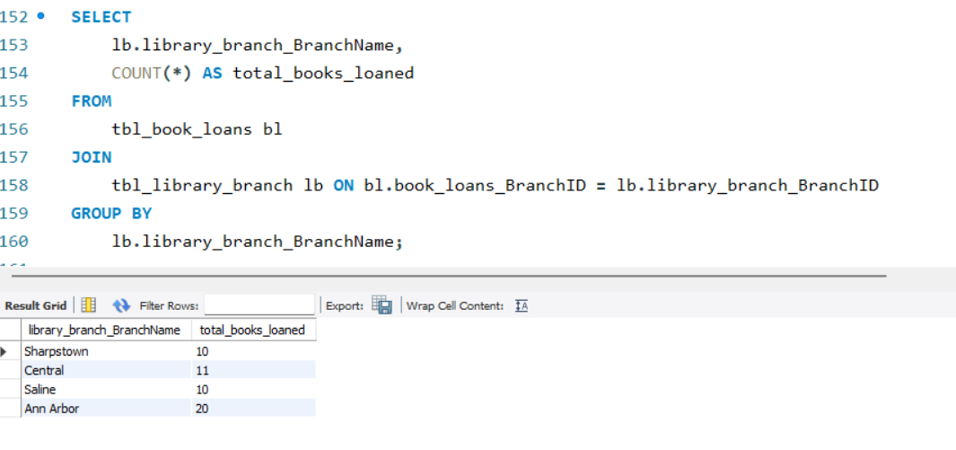
5.For each library branch, retrieve the branch name and the total number of books loaned out from that branch.

Slide 13
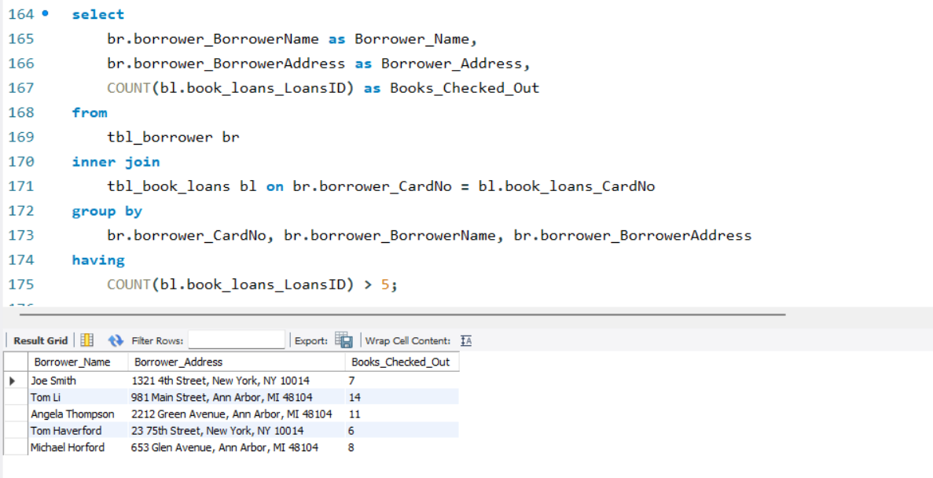
6.Retrieve the names, addresses, and number of books checked out for all borrowers who have more than five books checked out.

Slide 14
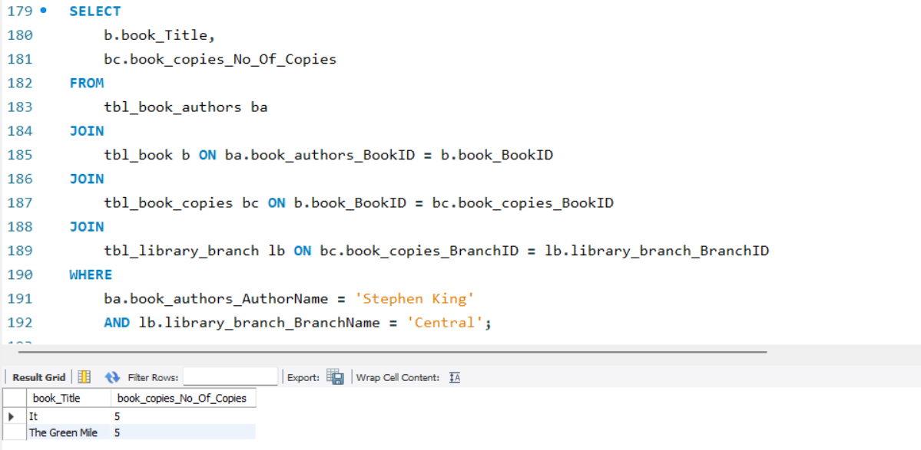
7.For each book authored by "Stephen King", retrieve the title and the number of copies owned by the library branch whose name is "Central".

Slide 15
Final Business insights and Recommendations
Key Insights:
Popular Books & Genres:
Certain book titles (e.g., “The Lost Tribe”) have been issued the most, indicating reader interest.
Fiction and educational books are the top-performing categories.
Active Borrowers:
A small group of users account for the majority of checkouts — potential loyal members.
Some users have overdue books or no returns, which affects availability.
Branch Performance:
Branches like Sharpstown have higher loan activity compared to others.
Some branches show low utilization of resources.
Loan Trends:
Peak borrowing happens during the first week of each month.
Weekends see fewer checkouts, suggesting opportunity for promotional events.
Recommendations:
Expand Collection Based on Demand:
Acquire more copies of popular books and related genres.
Regularly update the catalog based on top-loaned titles.
Improve Borrower Engagement:
Start reminder notifications for due dates and overdue books.
Introduce a reward program for frequent or timely borrowers.
Optimize Branch Operations:
Allocate resources to high-performing branches.
Organize events or promotions in underperforming branches to boost footfall.

Slide 16
Conclusion
The analysis of the library database provides valuable insights into book inventory management, borrower behavior, and overall operational efficiency. By leveraging data-driven decision-making, libraries can optimize the distribution of books, improve the borrowing experience for users, and streamline the allocation of staff and resources. The project emphasizes the importance of structured data analysis in identifying trends such as popular book titles, peak borrowing times, and underperforming branches. Moreover, the integration of automation and predictive analytics can further enhance library operations by forecasting demand, reducing manual workload, and ensuring that high-demand books are consistently available. Overall, this project highlights how a well-managed and data-informed library system can better meet user needs while maximizing the efficient use of resources.

Slide 17
Q&A
Any questions or feedback?
📖 “A library is not a luxury but one of the necessities of life — and data reveals its soul.” 📖

Slide 18
Challenges Working on SQL
Data Cleaning Issues Faced problems with duplicate entries and incorrect date formats that impacted query accuracy.
Complex JOIN Operations Writing JOIN queries across multiple tables like books, borrowers, and branches required careful attention to relationships and keys.
Query Optimization Needed to ensure queries were efficient and not unnecessarily slow, especially when working with filters and conditions.
Maintaining Data Integrity Ensuring the accuracy and consistency of data during import and analysis was critical.
Extracting Meaningful Insights Translating raw data into actionable insights while aligning with real-world library operations took extra effort and validation.

Slide 19

THANK YOU

